Slide 1
UWP Music Player with Myo Armband
Presentation by : Weichen Wang g00329371
Lecturer : Damien Costello
Module: Gesture UI Development / 4th Year

Slide 2
Purpose of the project
To demonstrate how to use the Myo Armband to detect the electrical activity of muscles.
Control gestures and highly sensitive motion sensors detected by proprietary EMG muscle sensor to control the application to perform a series of operations.

Slide 3
Gesture and Motion
For this project, I designed a few gestures to control the player:
1. Double Tap → Play
2. Fist → Pause
3. Wave In → Play Previous
4. Wave Out → Play Next
5. Fingers Spread → Stop

Slide 4
Architecture

Slide 5
Architecture
NavItem & ItemsBuilder: For Hamburger Menu.(setting button function of menu & Icon,Title,View).
Song.cs: include basic information of MP3 file.
SongManager: Get mp3 file and cover image from MusicCollections folder.
MyMuiscPage: Assign the song collection read from SongManager to the ItemSource of ListView.
SongPlayPage: Setting Player Main Functions and Myo Gesture Pose Detect.
MainPage: Setting Menu button event and Navigiate.

Slide 6
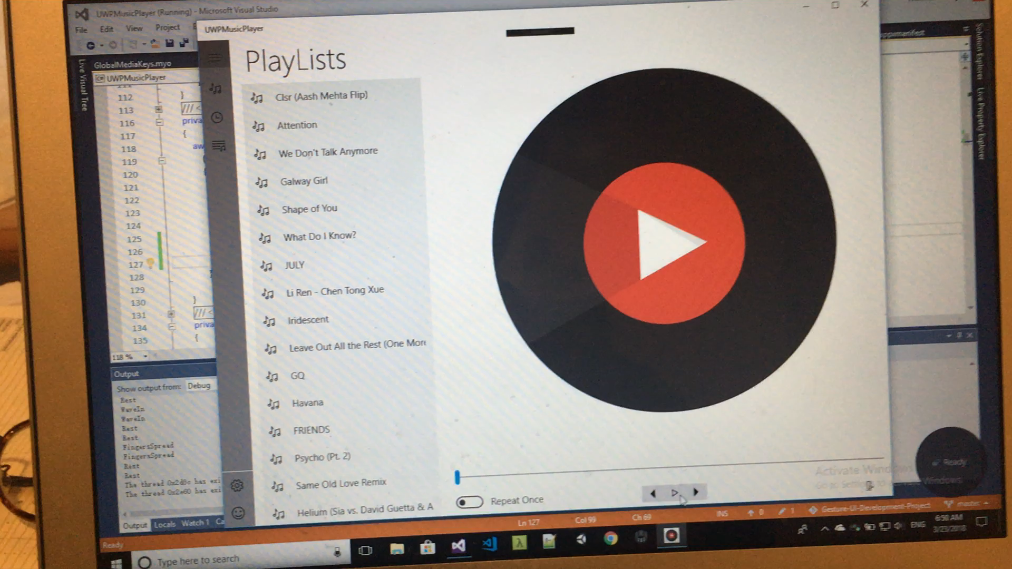
Demo Vedio link

